Slide 1

Module 5
Model Building
Notes:
Guidelines
Use section headers to chunk content in your presentation.
Use the same style of section header throughout your presentation.
Keep your title to no more than 2 lines.

Slide 2
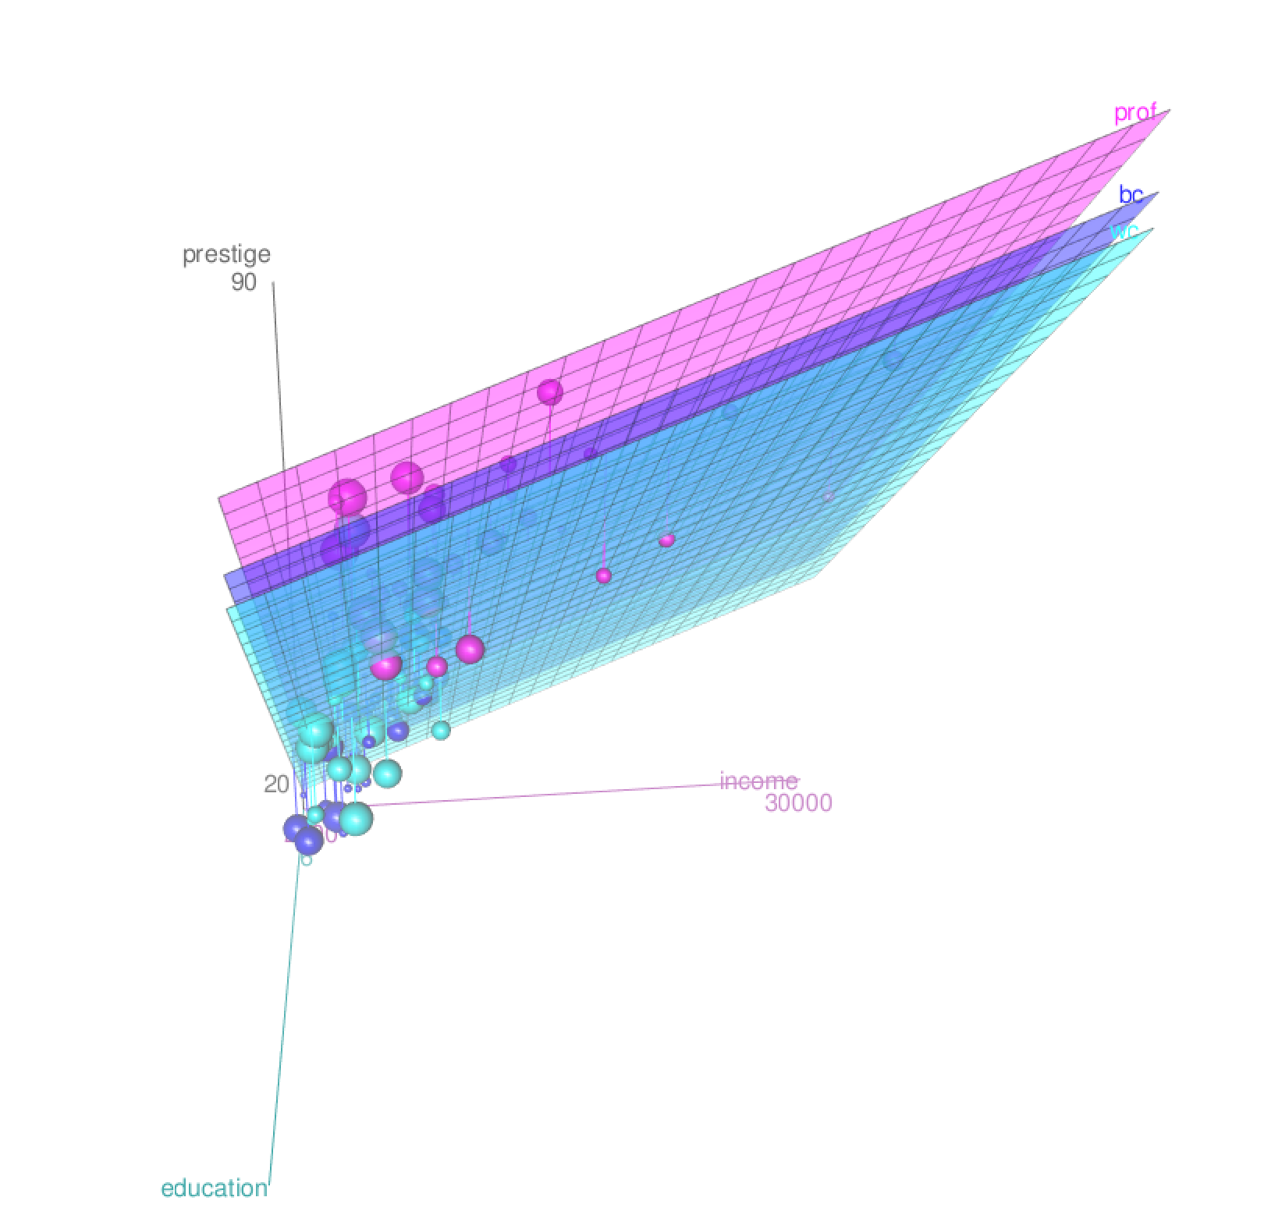
Model Complexity
Notes:
Guidelines
Use a title slide at the beginning of your presentation. There are 9 variations of title slides to choose from.
If you will have a series of slideshows, we recommend using the same style of title slide for each presentation.
Keep your title to no more than 2 lines.
Do not change the font style or font size of the title or subtitle.

Slide 3
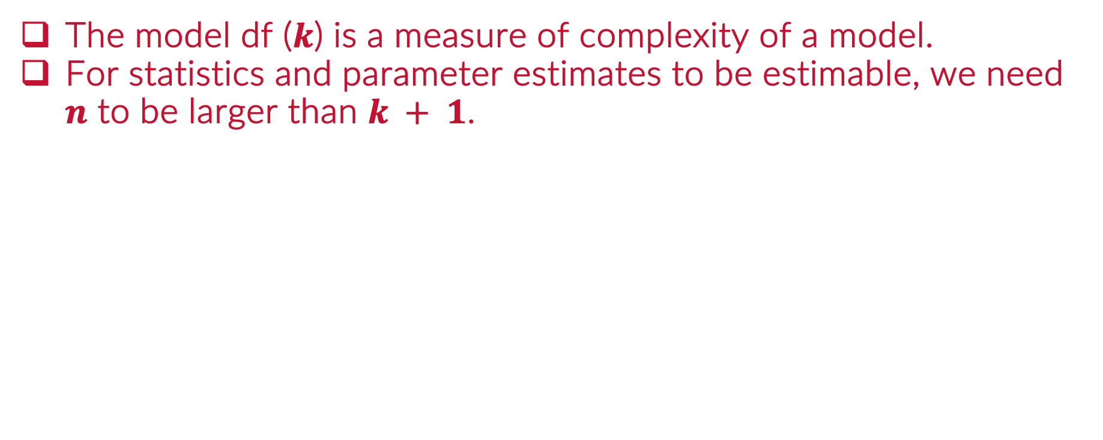
Model DF: Model Complexity
The model df ($k$) is a measure of complexity of a model.
For statistics and parameter estimates to be estimable, we need $n$ to be larger than $k + 1$.

Slide 4
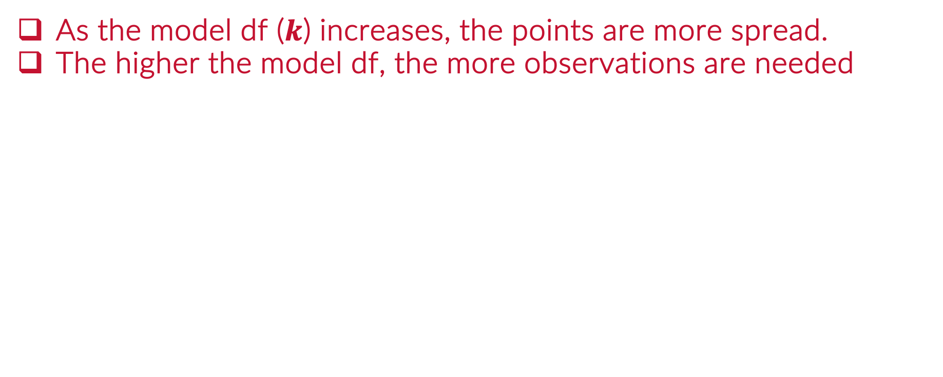
The Curse of Dimensionality
As the model df ($k$) increases, the points are more spread.
The higher the model df, the more observations are needed

Slide 5
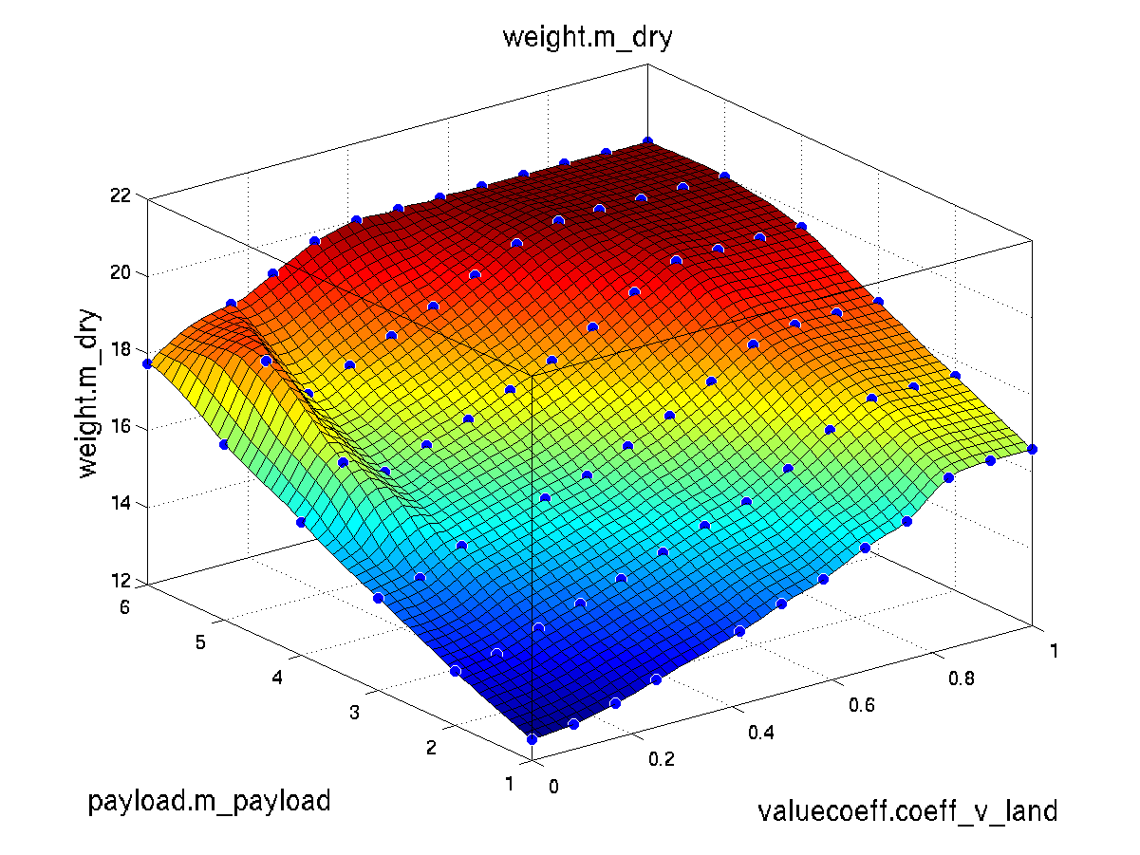
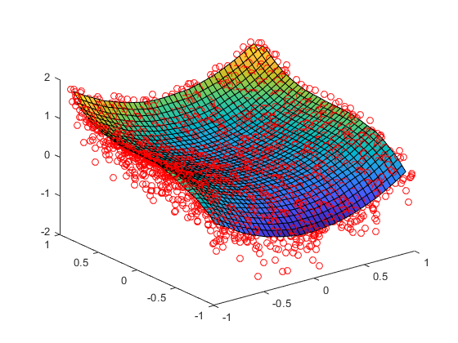

The Curse of Dimensionality
As the model df ($k$) increases, the points are more spread.
The higher the model df, the more observations are needed

Slide 6
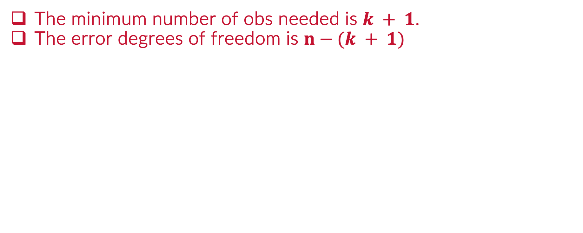
Error Degrees of Freedom
The minimum number of obs needed is $k + 1$.
The error degrees of freedom is $n−(k + 1)$

Slide 7
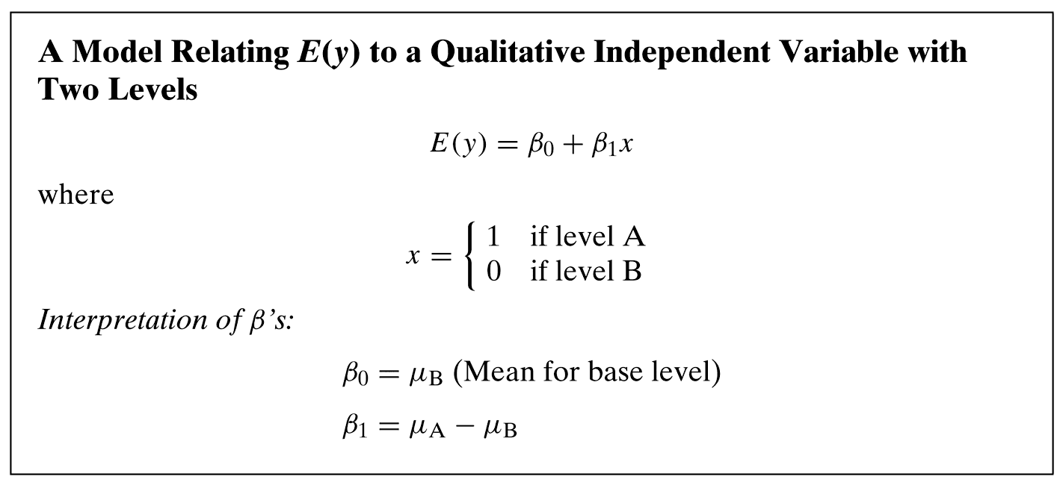
Dummy-Encoding and Complexity

Slide 8
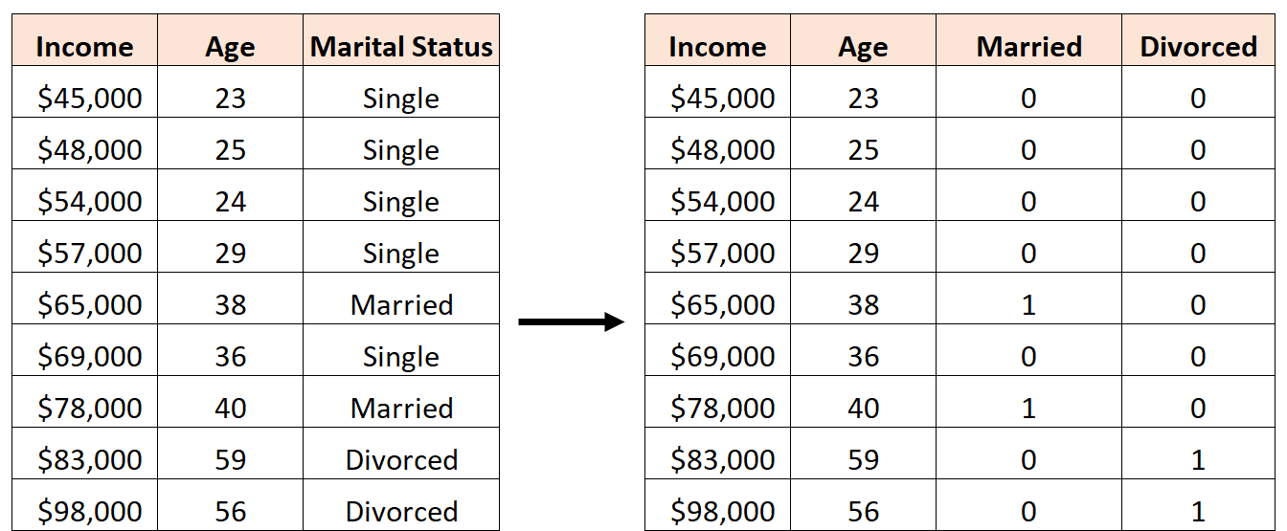
Model DF
Quantitative (Numeric) Predictors: contribute 1 model df
Categorical Predictors: contribute (# levels – 1) model df

Slide 9
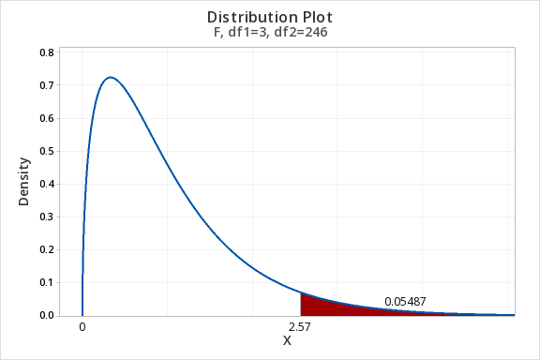
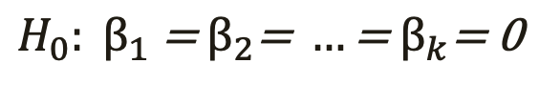
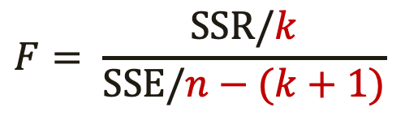
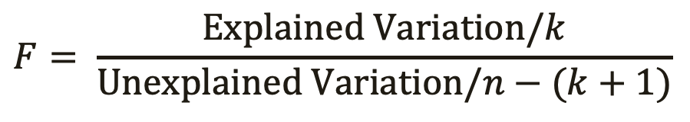
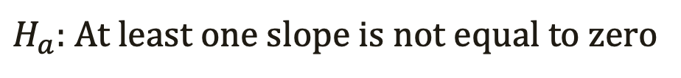
Overall Test of Significance
Hypothesis Test
Test Statistic
$$H_{0}: β_{1}\text{ = }β_{2}\text{= }…\text{= }β_{k}\text{= 0}$$
$H_{a}:$ At least one slope is not equal to zero
$$F= \frac{Explained Variation/k}{Unexplained Variation/n−(k+1)}$$
$$F= \frac{SSR/k}{SSE/n−(k+1)}$$
Numerator df (MODEL DF)
Denominator df (ERROR DF)

Slide 10
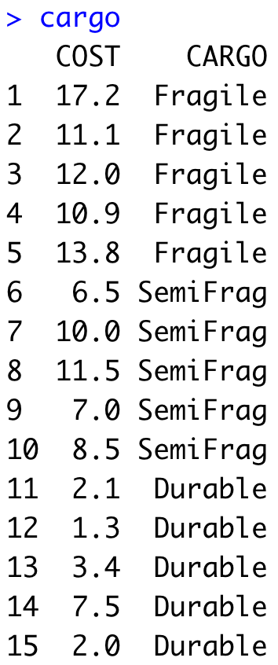

Example: CARGO Cost
Predict Cost of Cargo using CARGO type

Slide 11
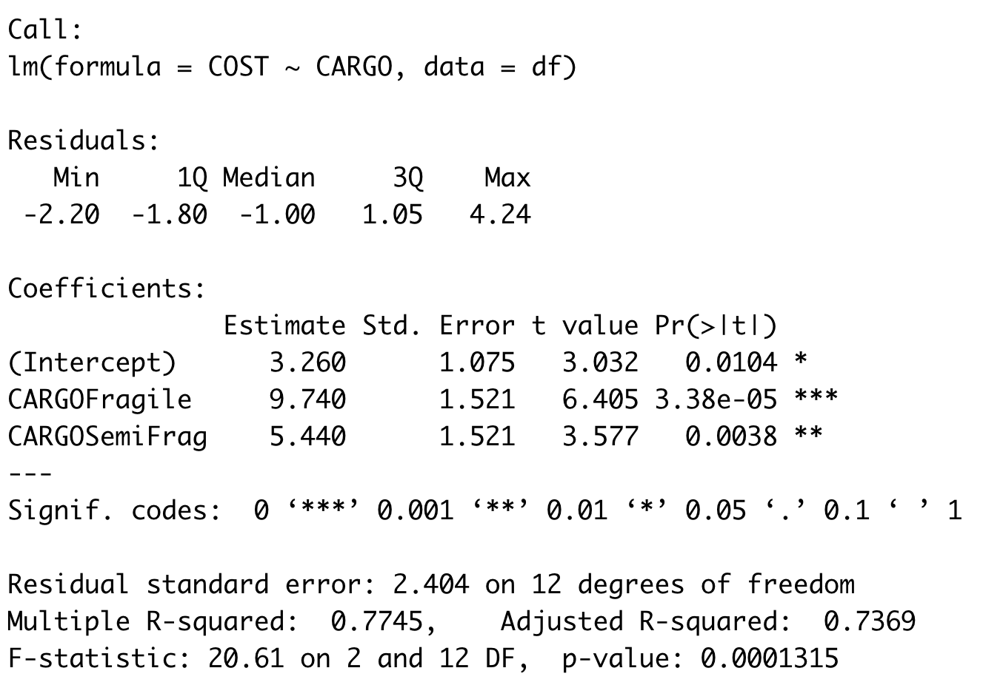
Example: CARGO Cost
Parameter Estimates

Slide 12
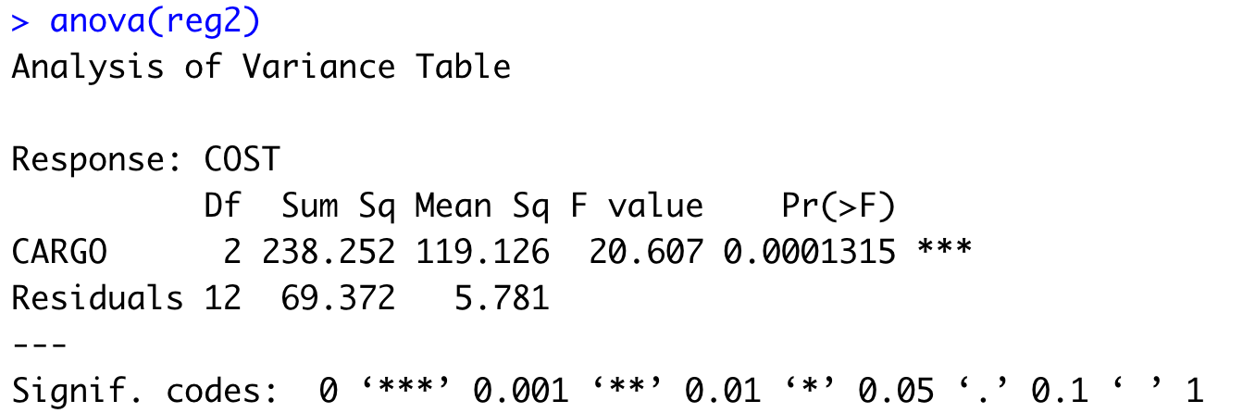
Example: CARGO Cost
ANOVA

Slide 13
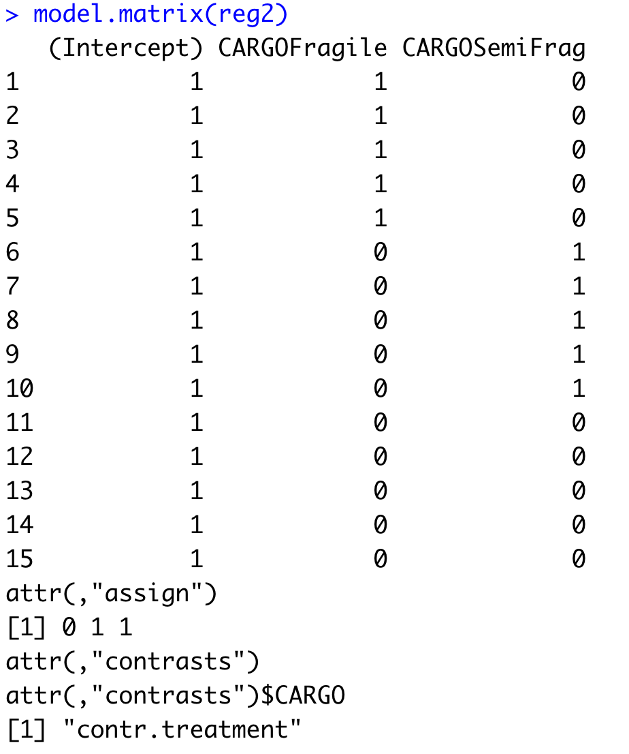
Example: CARGO Cost

Slide 14
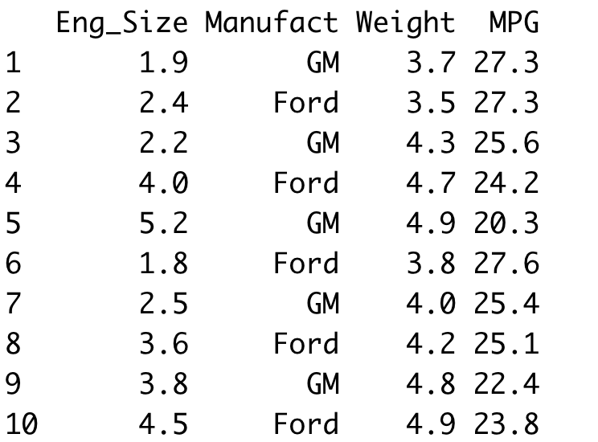
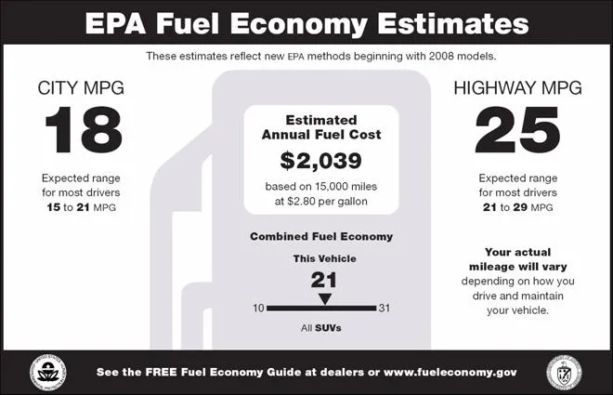
Example: MPG Prediction
Predict Combined MPG based on Manufacturer, Engine Size and Weight

Slide 15
Example: MPG Prediction
Encoding variable Manufact
0 if Manufact = “GM”
ManufactFord =
1 if Manufact = “Ford”

Slide 16
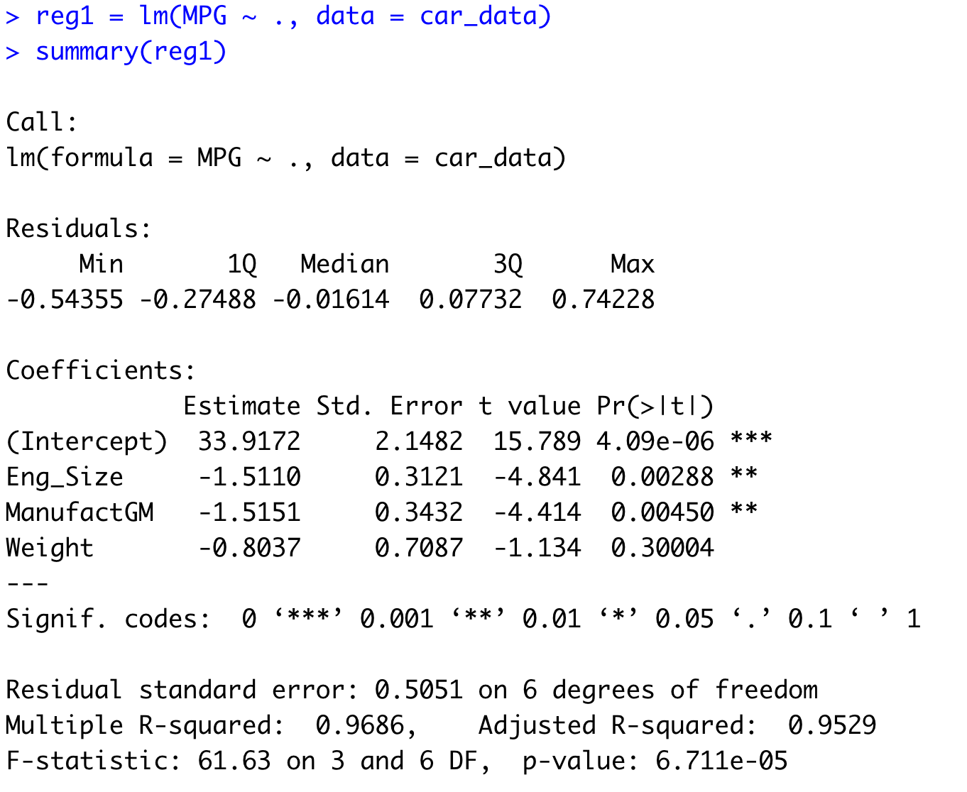
Example: MPG Prediction

Slide 17
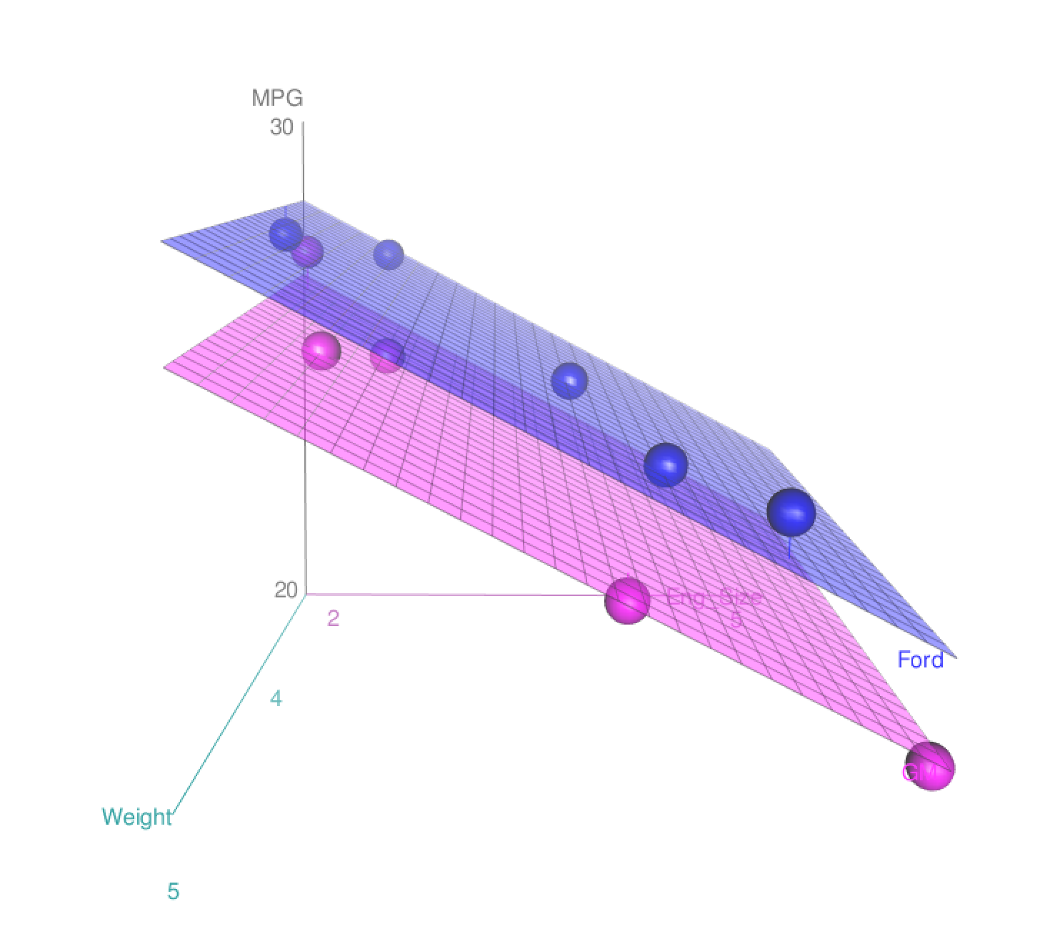
Example: MPG Prediction

Slide 18

Practice

